Slide 1
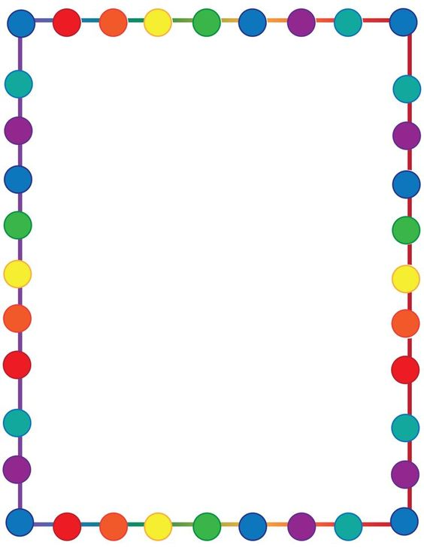
ADJETIVES

Slide 2
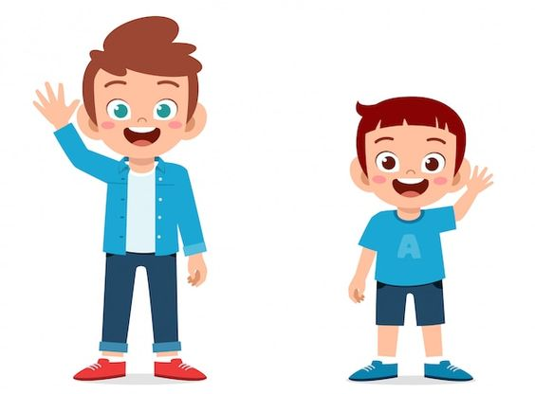
TALL SHORT

Slide 3
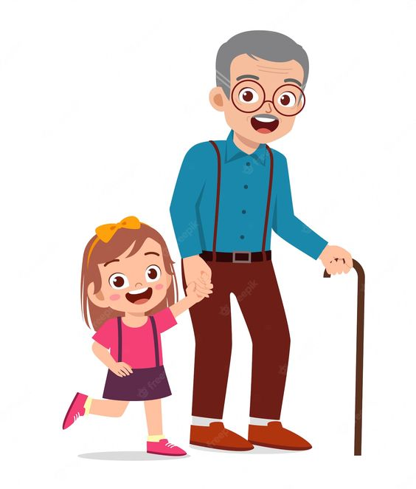
OLD
YOUNG

Slide 4
BIG
SMALL

Slide 5
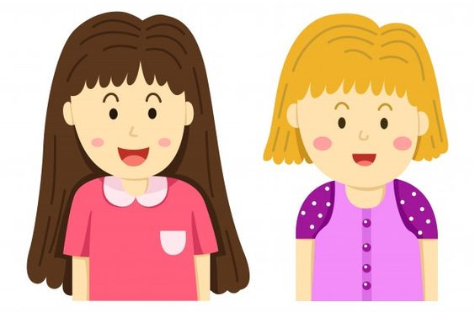
LONG
SHORT

